Slide 1
Social Physics, Ensemble, and You!
Ben Samuel
May 22nd, 2015
bsamuel@soe.ucsc.edu
Notes:
Hello, my name is Ben Samuel, I'm a PhD student in the Expressive Intelligence Studio here at Santa Cruz, and I'm here to talk to you today about Social Physics and the Ensemble Engine, which is an example of a social physics engine?

Slide 2
Social Physics?
What are we even talking about here?
Notes:
What do I mean by social physics? Let alone social physics engine?

Slide 3
First Things First
Lets take a brief detour into what a traditional physics engine does.
Notes:
That’s a great question! To answer it, lets take a look at "normal" physics engines.

Slide 4

Traditional Physics Engine: Gravity!
Notes:
Normal physics engines make it easy to work with things like gravity,

Slide 5

Traditional Physics Engine: Momentum!
Notes:
Or momentum, and other forces, and integrate all of these things into your game

Slide 6

Traditional Physics Engine: Great!
Notes:
Freeing game designers from having to keep track of, or even code themselves, how all of these complex forces interplay with each other.

Slide 7

Physics Models can be Very Powerful
Notes:
And although when you think "physics engine" it might give you an idea of powerful things that come in big boxes…

Slide 8
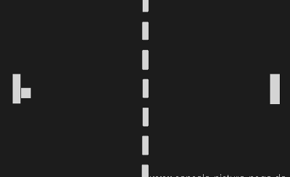
Physics Models can be Simple!
Notes:
Even simple games leverage the basic concepts of physics in procedural ways (show video of pong)
It might be a stretch to say that any given incarnation of Pong uses a physics *engine*, but it does do things like keep track of the direction and speed of the ball, and it figures out new directions and speeds based on the angle that it hits walls or paddles. Simple as it may be, its still using a form of *physics.*
The thing is, uses of physics like this are so common we frequently take them for granted, but without these dynamic physics systems, the game play experience would be vastly different. Can you imagine a version of pong without physics?

Slide 9
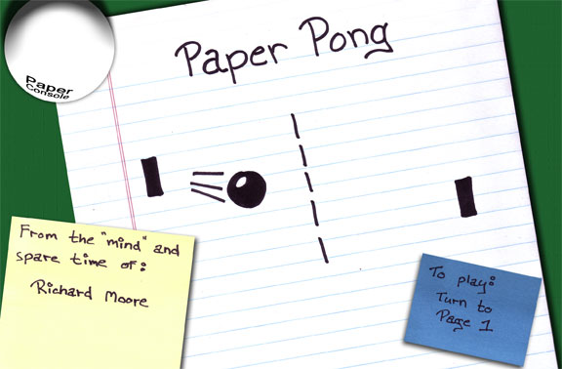
Physics-Less Pong
Notes:
Well, good news, you don’t have to imagine it because someone else made it already! This is Paper Pong! Paper Pong is a coffee table book, like, an actual, physical book that would sit on your actual, physical coffee table. Its what Pong would look like without its dynamic physics set up.

Slide 10
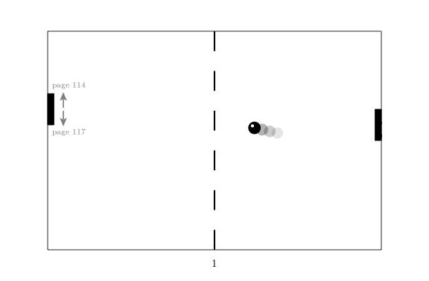
Paper Pong – Page 1
Notes:
The game has been stripped of its procedurality, and every page is an instantial asset, crafted by hand. Each page represents a different snapshot of game state, capturing things like the location of the player’s paddle, and the direction the ball is headed in. And the way you play this book/game is by turning to the page you want to ‘move your paddle’ to while the rest of the game world continues on its trajectory. So, here we’ll move our paddle down by turning to page 117.

Slide 11
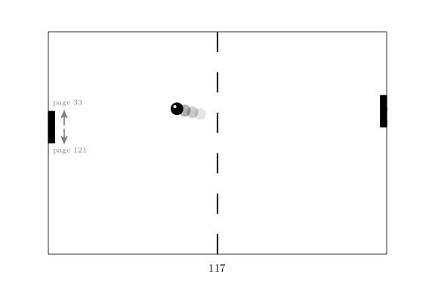
Paper Pong – Page 117
Notes:
So just to be clear, every page.

Slide 12
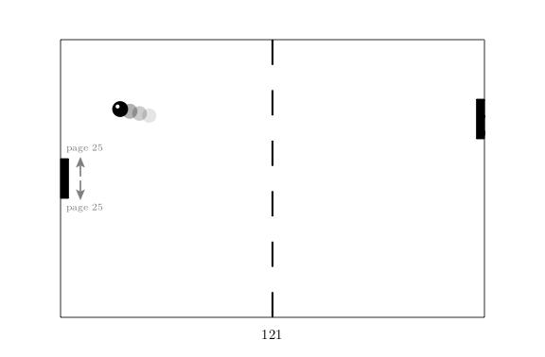
Paper Pong – Page 121
Notes:
Every ‘turn to page X’ link,

Slide 13
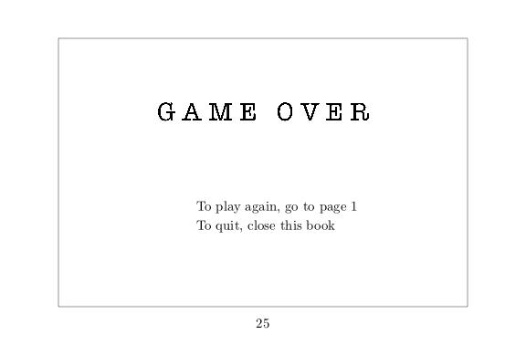
Paper Pong – Page 25
Notes:
was painstakingly created by a human author.

Slide 14
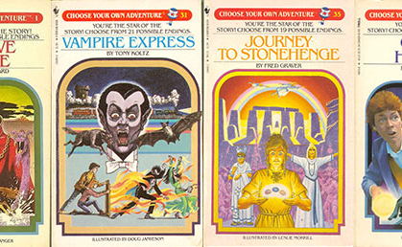
Sound Familiar?
Notes:
This idea of having to hand-specify all of the potential paths through a game might strike some of you as being reminiscent of a Choose Your Own Adventure book.

Slide 15
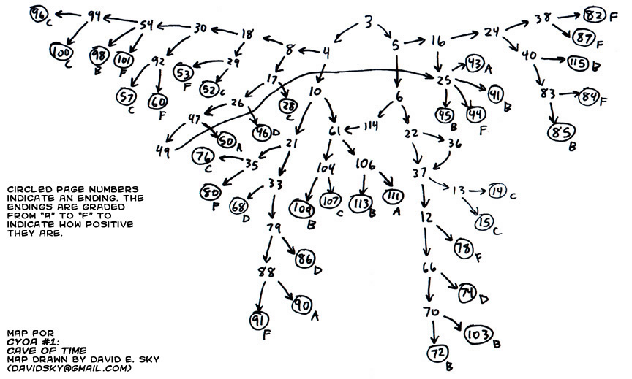
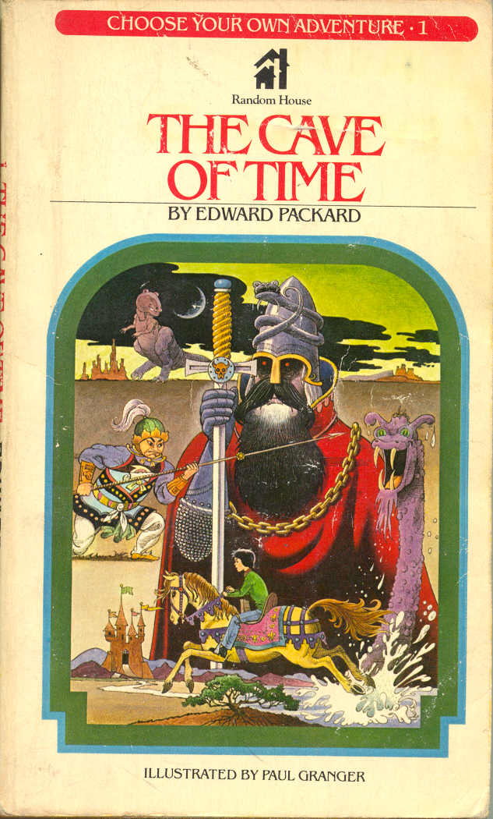
CYOA Possibility Space
Notes:
Choose Your Own Adventure books are the Paper Pongs of the interactive storytelling world. All of the possible paths through a story were planned out and penned ahead of time. And as such, the possibility space for experiencing the stories are limited by what a human author is capable of producing.

Slide 16

An Artifact From Yesteryear?
Notes:
And, perhaps needless to say to anyone whose read a choose your own adventure book, not all paths through the story are equally satisfying. But surely this lack of a dynamic, perhaps unsophisticated interaction system, is just because these were some of the first forays into interactive storytelling?

Slide 17
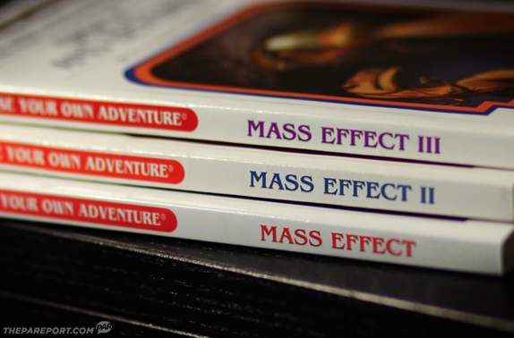
It Still Happens Today!
Notes:
Well surprise surprise, this is frequently the type of structure you get when you play AAA games—even games which have an emphasis on story.

Slide 18
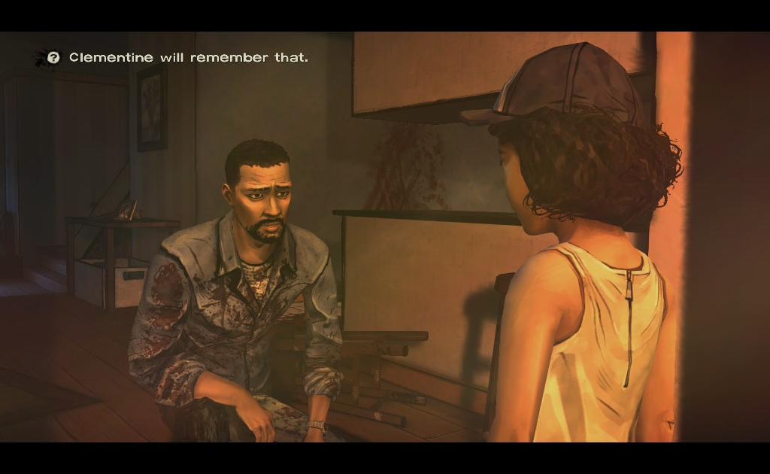
Games Often Hint at Narrative Complexity…
Notes:
Many story games try to convince players otherwise that the narrative is being influenced by a rich, dynamic simulation of the character’s populating the game, such as in TellTale’s The Walking Dead. As the player makes decisions, the game informs the player that characters will remember decisions you made. So here, Clementine, the girl with the hat in the foreground, is going to remember something that Lee, the player character, said. But Keven Bruner, CEO of TellTale, has even gone on record to say that sometimes those messages pop up and there is *no* internal simulation, nothing behind the scenes keep track of it. Clementine, might in fact, not remember that!

Slide 19
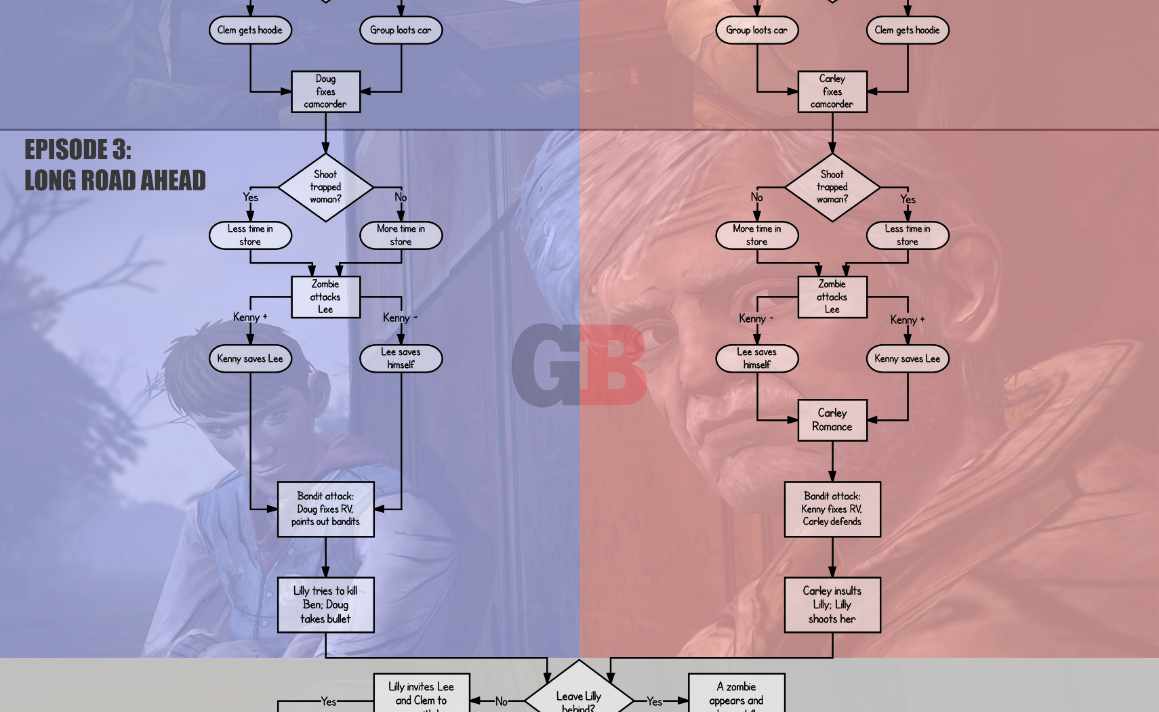
… That Doesn’t Manifest.
Notes:
That means that these games frequently boil down to simple quest flags, branching you down one of a handful of different narratives, with perhaps touches of unique narration depending on the history of choices you've made. In spite of the many choices player’s can make in The Walking Dead, there’s only a small handful of narratively meaningful variations in the plot. And although it’s maybe a little hard to see, at the bottom of this chart we can see both of these main branches collapsing back into each other to a single point.

Slide 20
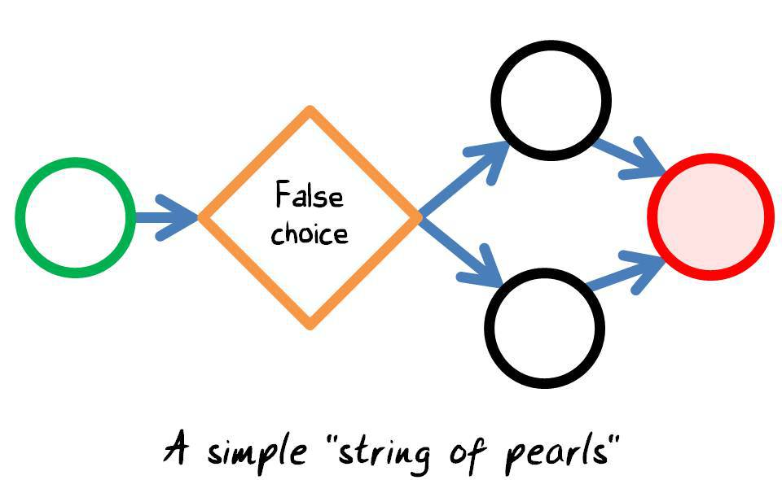
A String of Pearls
Notes:
This is a somewhat common technique in the domain of interactive storytelling. There may indeed be divergences in the narrative based on choices you’ve made, but they’ll frequently all collapse back to a single point, resulting in a narrative structure known as a String of Pearls. As the story continues, later pearls tend to have little to no reference to your past actions and decisions as a player. And *to be fair* its understandable why. We just saw Paper Pong is nearly 200 pages long, and the only decisions you can make are to move the paddle up and down! Imagine trying to hand-write well-crafted beautiful unique stories for every player decision in a story game! It would quickly grow untenable for a writer to account for every choice! So its an understandable concession! It’s a really hard problem! So let me take this moment to say that I think that The Walking Dead and Mass Effect and others of their ilk all *remarkable* games and worthy of copious praise and acclaim. I’m just pointing out that the technology driving their narratives isn’t necessarily that sophisticated.

Slide 21
Okay, Where Were We Again?
So, uh, what exactly is Social Physics?
Notes:
OKAY.
<breath>
What were we talking about? Oh yeah, social physics.
So, what is social physics? Well, among other things…

Slide 22
Social Physics
It’s an attempt to leverage the same dynamism of “normal” physics in a narrative setting.
Notes:
It’s an attempt to leverage the dynamism of “normal” physics in a narrative setting.

Slide 23
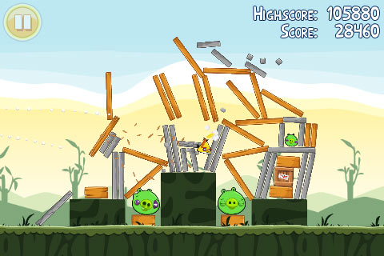
It All Comes Crashing Down
Notes:
So just like how in Angry Birds, you land that perfect shot and everything dynamically falls into place...

Slide 24

It All Comes Crashing Down?
Notes:
We want there to be social situations with high potential energy that you can interact with and the system will automatically deal with the social fall out.

Slide 25
Social Physics
We want to make social situations *playable*
Notes:
In Short, We want to make social situations playable.

Slide 26

Social Physics in Action
Notes:
One of the few examples of this that have been made so far is the game Prom Week

Slide 27
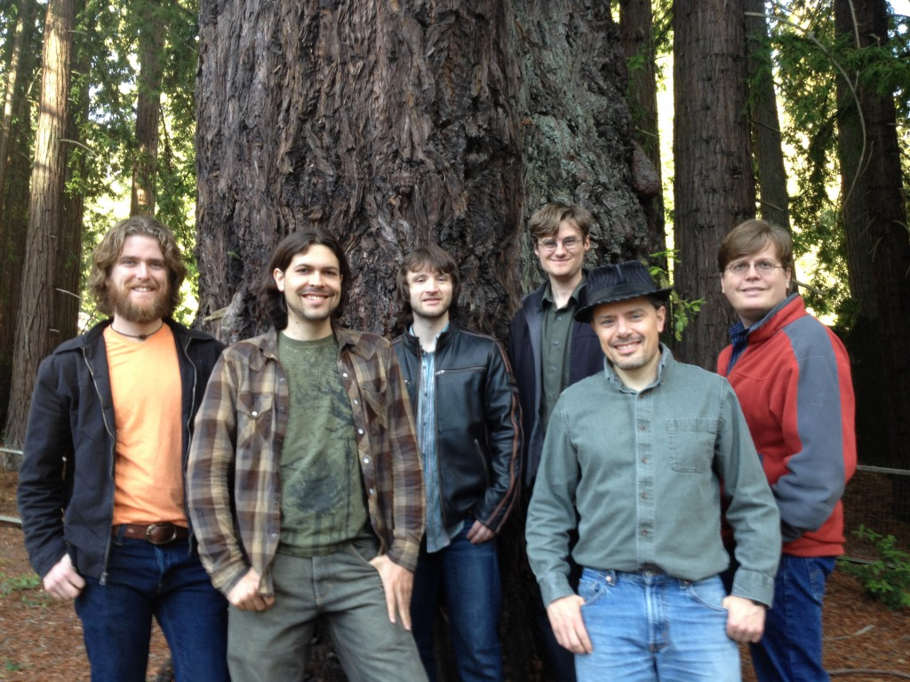
Team Prom Week
Notes:
Prom Week was made by many people

Slide 28
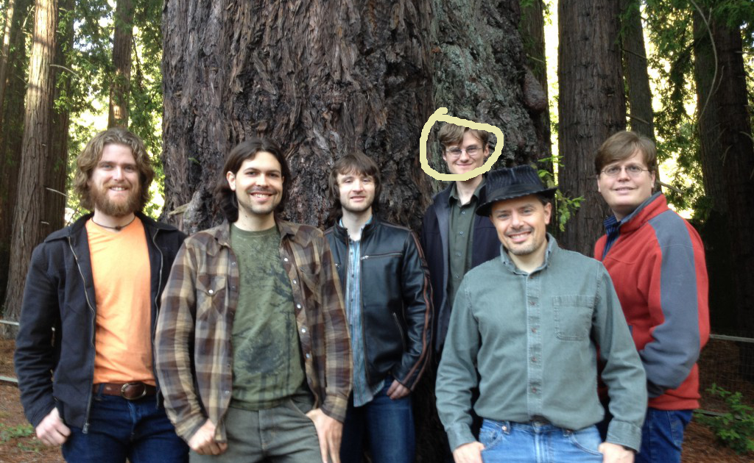
Team Prom Week
Notes:
Including myself…

Slide 29
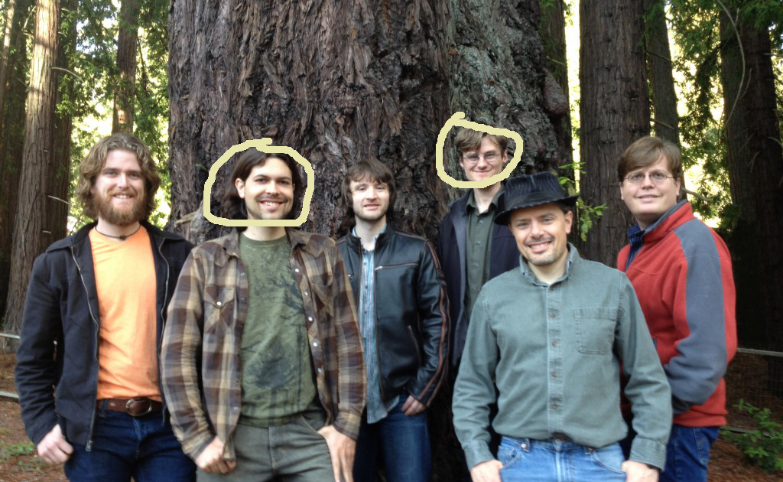
Team Prom Week
Notes:
Aaron Reed, who literally *wrote the book* on Interactive Fiction. Or at least the book that you’ve been reading in this class.

Slide 30
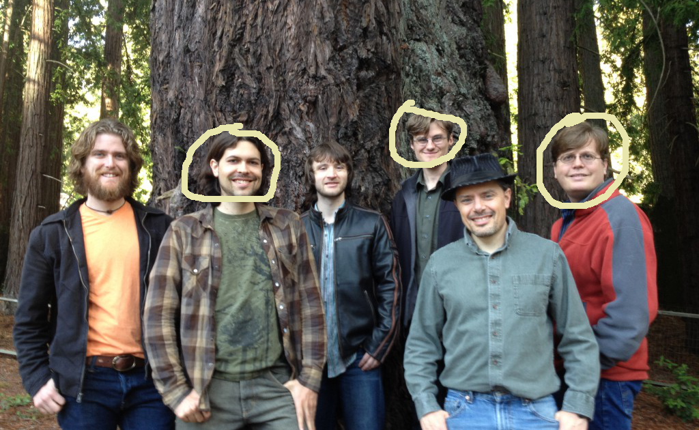
Team Prom Week
Notes:
Noah Wardrip-Fruin, who wrote the OTHER BOOK that you’ve been reading (Expressive Processing)

Slide 31
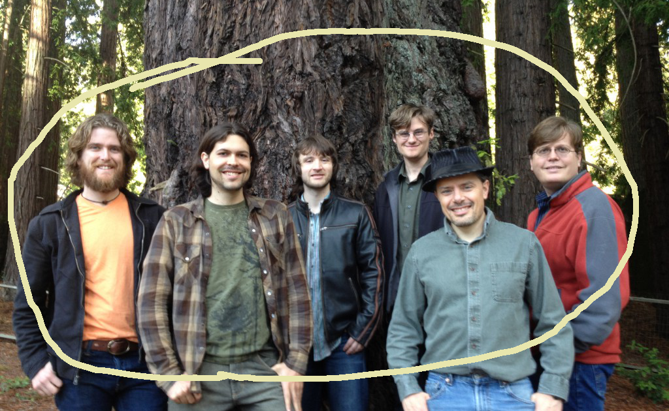
Team Prom Week
Notes:
Our collegues/faculty Josh McCoy, Mike Treanor, and Michael Mateas

Slide 32
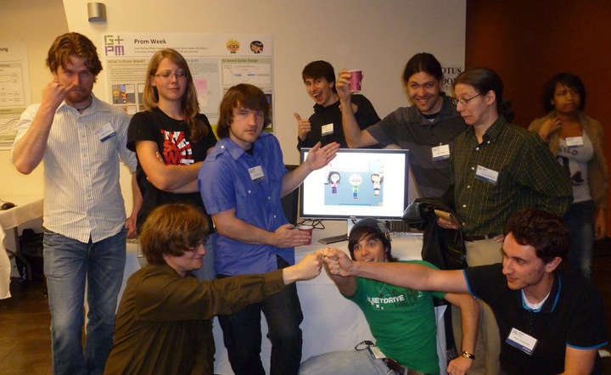
Team Prom Week
Notes:
and a veritable bevy of undergraduate students, not unlike yourselves, who wanted to get involved with games research.

Slide 33
A Prom Week Primer
A brief overview/introduction.
Notes:
We’ll start with a little overview of how gameplay in Prom Week works before we dive into its architecture and how it enables social physics.

Slide 34
A Prom Week Primer
A brief overview/introduction.
Dramatic Week Before Prom
Notes:
As its name implies, Prom Week takes place in the dramatic week before a high school Prom. Players choose a character’s campaign, which will task the player with achieving certain social goals for that character.

Slide 35
A Prom Week Primer
A brief overview/introduction.
Dramatic Week Before Prom
Achieve social goals by massaging the social state.
Notes:
These goals might range from classic prom-incentives such as getting a date, to more vindictive offerings such as giving a notorious bully his comeuppance. Though the goals vary by campaign, the means of achieving them remains the same: you massage the social state of the world to suit your needs!
Describing the basic interaction of loop of Prom Week is pretty simple. Every turn you as the player will pick a character, pick a second character, choose something for the first character to do with the second character, and voila! Do it again! Easy!

Slide 36
A Prom Week Primer
Basically:
  You pick a character
  You pick a second character
  You pick something for the first character to do with the second character.
  Rinse and Repeat.
Notes:
Describing the basic interaction of loop of Prom Week is pretty simple. Every turn you as the player will pick a character, pick a second character, choose something for the first character to do with the second character, and voila! Do it again! Easy!

Slide 37
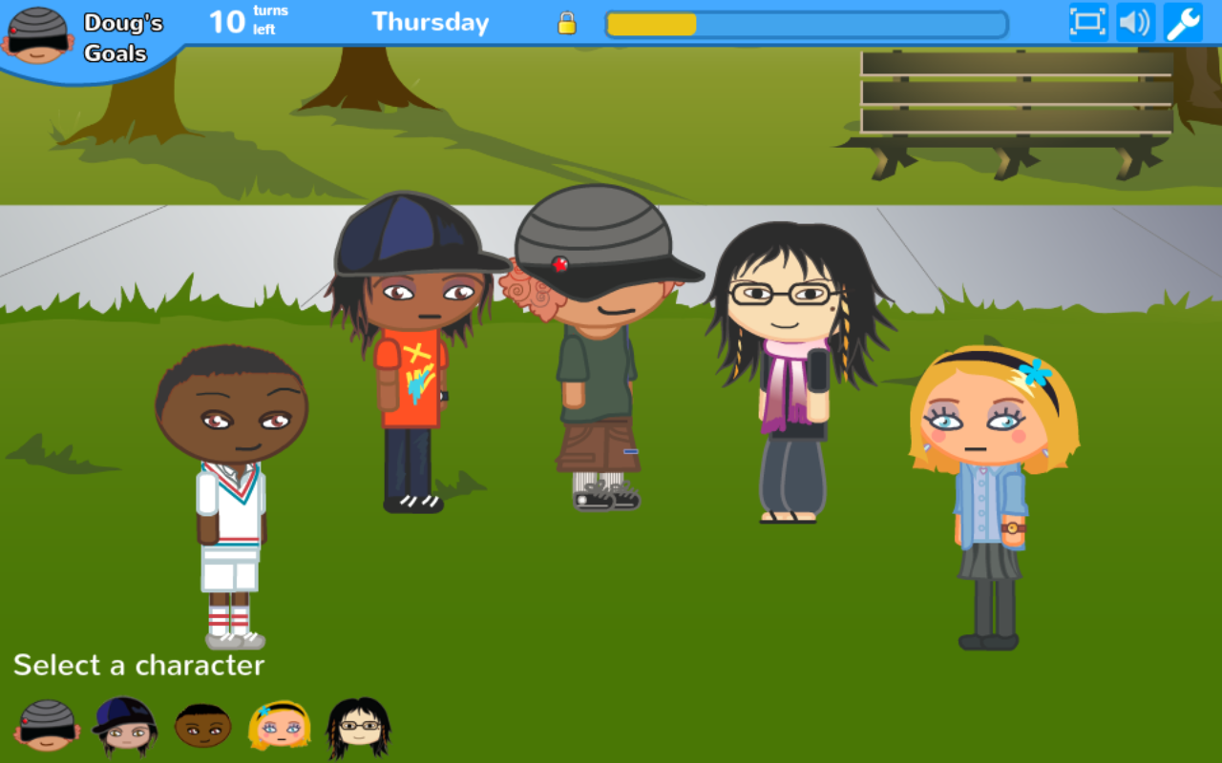
A Prom Week Primer
Notes:
So, this is what a typical level in Prom Week looks like. You can click on any of these characters. Let’s pretend that we clicked on Oswald, who is the guy on the far left, and then let’s pretend we clicked on Doug, who is the guy in the middle wearing the hat.

Slide 38
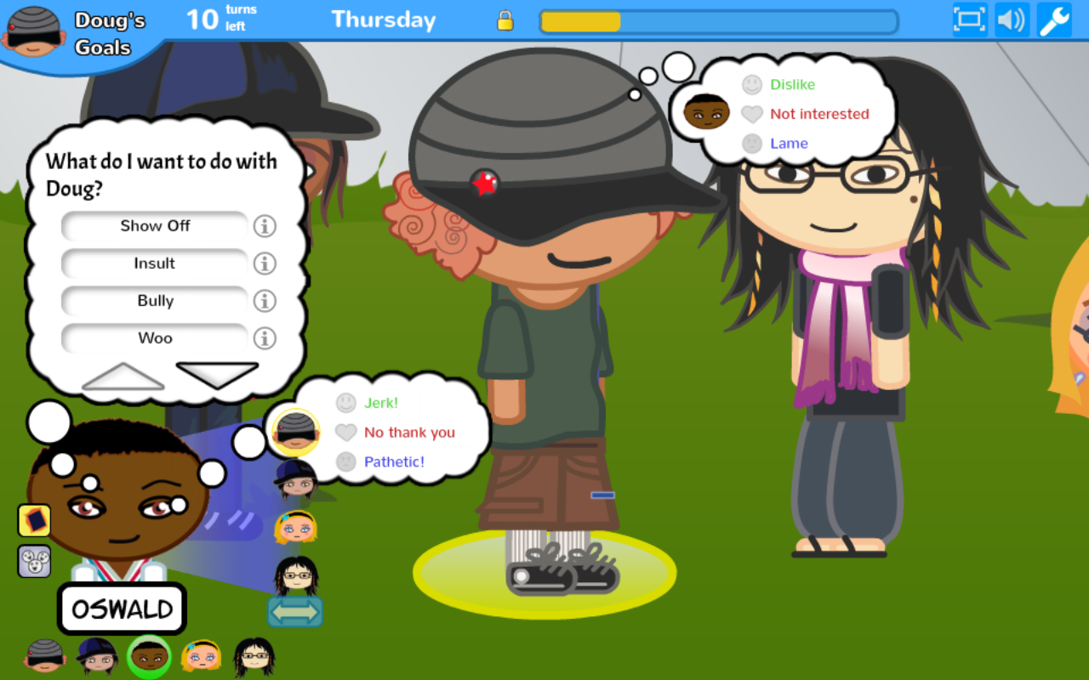
A Prom Week Primer
Notes:
We’d be presented with a screen that looks like this. On the left here, in the thought bubble, you can see all of the things that Oswald wants to do with Doug, things like Show Off, Insult, and Bully. So it looks like Oswald doesn’t really like Doug very much. However, we can see that he also wants to Woo him, hinting that their relationship, or at least Oswald’s feelings for Doug, might be a little more complex than they appeared at first glance. There seems to be something under the surface that is making Oswald want to take these seemingly contradictory actions towards Doug.
This leads us to a Big Question whose answer will help show how social physics are used in Prom Week:

Slide 39
Big Question
How do characters decide what they want to do with each other?
Notes:
How do characters decide what they want to do with each other? Answering this question is going to teach us all many things about how the guts of Prom Week work. There’s a lot of factors involved, so it’s a little complex. But, one thing that’s *not* complex is first saying what the answer *isn’t*.

Slide 40
NOT the Answer
We just hand wrote every choice!
Notes:
The game authors did *not* hand author every character action choice!

Slide 41

NOT the Answer
Notes:
This is not Paper Pong! The system is dynamically figuring out what the characters want to do at every turn of the game. And because of that the number of ‘branches’ that are possible are far beyond anything that would be capable of being produced by hand.

Slide 42
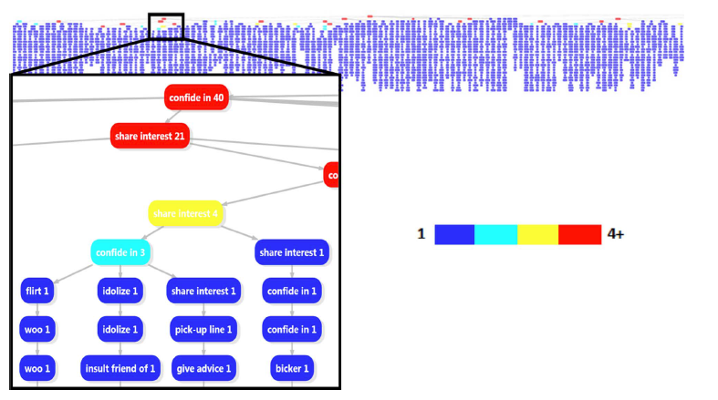
The Power of Dynamic Narrative
Notes:
To give you a sense as to the branching factor, let’s take a look at a visualization of actual player’s play throughs of a campaign of Prom Week. Each one of those vertical blue lines represents a different real-world player’s path through the game. This band represents about 1 third of the total plays of that single campaign of Prom Week (of which we have about 10), and although some of them start off the same (as we can see in this insert, any box that isn’t colored in blue means that multiple players went down the same path), they all quickly turn into paths that no other player experienced before. And again, those are all paths made by actual players and it already doesn’t fit on the slide. If we were visualizing the total amount of *possible* traces of the campaign, this would be astronomically bigger!

Slide 43
The Power of Dynamic Narrative
Dynamic
Instantial
Notes:
This is the potential power of dynamic narrative! Of social physics! So, how do we do it?

Slide 44
The Actual Answer
Influence Rules and Social State!
Notes:
Well… the way that Prom Week does it is through a slew of “influence rules” that reason over the social state. We’ll dive into those in just a second, but just so you know where we’re going, the influence rules will look at the current social state to form character volitions.

Slide 45
The Actual Answer
Influence Rules and Social State!
These are used to form character volitions
  i.e. I want to STARTDATING Doug, I want to DECREASEBUDDY with Oswald, etc.
Notes:
These volitions are very high-level goals that the characters will form with each other, such as Starting to date each other, or raising or lowering affinity for each other.

Slide 46
The Actual Answer
Influence Rules and Social State!
These are used to form character volitions
  E.g., I want to STARTDATING Doug, I want to DECREASEBUDDY with Oswald, etc.
Which in turn are translated into specific actions
  Ask Out! Insult! Woo!
Notes:
Once the characters have formed their volitions for each other, there is a separate process that picks the best social exchange or the best action for that character to take towards their target, such as asking them out, or insulting them, or wooing them.

Slide 47
The Actual Answer
Influence Rules and Social State!
These are used to form character volitions
  i.e. I want to STARTDATING Doug, I want to DECREASEBUDDY with Oswald, etc.
Which in turn are translated into specific actions
  Ask Out! Insult! Woo!
Notes:
But let’s just focus on these guys, right now. The influence rules and the social state.

Slide 48
The Social State
Notes:
Let’s start with the social state, as I think it’s a little easier to groc.

Slide 49
The Social State
Social Facts
Notes:
The social state is made up of a bunch of social facts.

Slide 50
The Social State
Social Facts
  Doug has the trait humble.
  Chloe has the status has a crush on Doug.
  Oswald and Doug have the relationship enemies.
  And many more!
Notes:
Each one of these facts is describing some truth about the world. Some sample facts might be that Doug has the trait humble, Chloe has the status “has a crush on Doug” and Oswald and Doug are enemies.

Slide 51
The Social State
Social Facts
  Doug has the trait humble.
  Chloe has the status has a crush on Doug.
  Oswald and Doug have the relationship enemies.
  And many more!
The “Starting State” details many such facts.
Notes:
And when you first launch the game, the world is full of social facts such as these, known as “the starting state.” The starting state makes up the backstory of the world (we wanted these characters to feel like they had a history with each other, as if you’re coming in in medias res)

Slide 52
The Social State
Social Facts
  Doug has the trait humble.
  Chloe has the status has a crush on Doug.
  Oswald and Doug have the relationship enemies.
  And many more!
The “Starting State” details many such facts.
Gameplay will change the social state significantly.
Notes:
Playing the game will of course change the state social state of the world significantly.

Slide 53
The Social State
Social Facts
  Doug has the trait humble.
  Chloe has the status has a crush on Doug.
  Oswald and Doug have the relationship enemies.
  And many more!
The “Starting State” details many such facts.
Gameplay will change the social state significantly.
Notes:
We can see that most social facts have to deal with individual characters and their relationships with one another.
And that we have categories of social facts, including traits, statuses, and relationships. Lets take a moment to talk about the differences between these categories of social facts, starting with traits.

Slide 54



The Social State: Traits
Traits pertain to an individual character.
Never change
Humble
Pacifist
Friendly
Clumsy
Arrogant
Stylish
Notes:
Traits, in Prom Week, always pertain to a single individual character, they never change, and are meant to generally distinguish characters from one another. So, here we see three characters, Doug, Chloe, and Monica, with two traits apiece – Doug’s a humble pacifist, Chloe is friendly but clumsy, and Monica is arrogant but her fashion sense is exquisite. So, we have a snooty rich girl, a lovable klutz, and a hippie skater boy.
This is also perhaps a good time to mention that: we do not claim that Prom Week is an accurate representation of a real life high school experience. Instead, what we did to create the types of traits (and other social facts in the world) is we did an in-depth ethonographic analysis of existing pieces of media that depict highly dramatized high school experiences. So, er, in English that essentially means that we watched a lot of

Slide 55
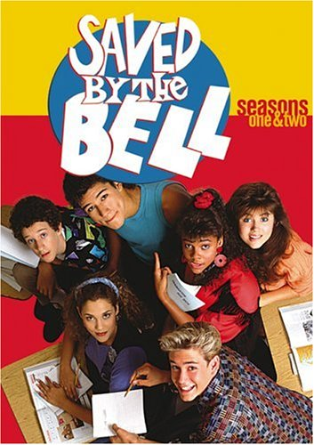
The Social State: Traits
Traits pertain to an individual character.
Never change
Humble
Pacifist
Friendly
Clumsy
Arrogant
Stylish
Notes:
Saved by the Bell…

Slide 56

The Social State: Traits
Traits pertain to an individual character.
Never change
Humble
Pacifist
Friendly
Clumsy
Arrogant
Stylish
Notes:
…Mean Girls…

Slide 57
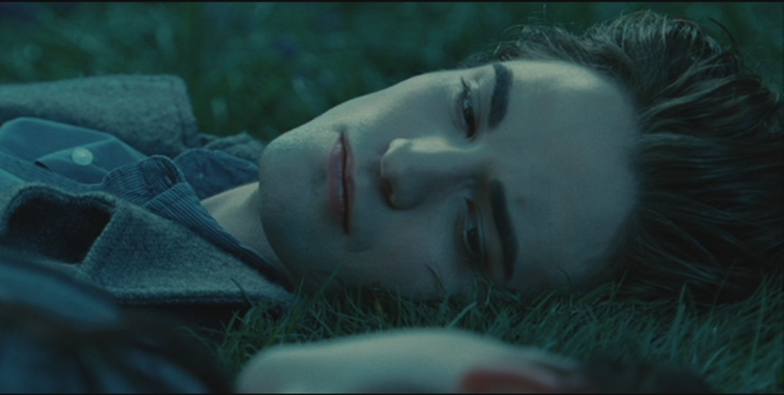
The Social State: Traits
Traits pertain to an individual character.
Never change
Humble
Pacifist
Friendly
Clumsy
Arrogant
Stylish
Notes:
Twilight. So, given our source material you can see how some of these character descriptions might feel a bit cliched
But, in fact, at least to a certain degree cliché-ness was an intentional design choice! We want players to be able to leverage that knowledge of high school cliches to bootstrap their play, and give them a starting point to make forward progress in solving the puzzles of the game! So, as we move forward in this discussion, if you find that your thinking to yourself “gee, some of these characters seem an awful lot like stereotypes” then, ah, you’re not wrong!

Slide 58
The Social State: Statuses
Come in two flavors
  Directed – One character’s feelings about a second.
  Undirected – Pertains to a single character, like traits.
Time out.
Notes:
Anyway, jumping back to aspects of the social state. There are statuses, that come in two flavors: directed and undirected. Directed statuses are about one character’s feelings about a second character. Undirected statuses pertain to a single character, like traits.
They time out (i.e., go away) if the conditions to create them aren’t kept.

Slide 59
The Social State: Statuses (Directed)
Come in two flavors
  Directed – One character’s feelings about a second.
  Undirected – Pertains to a single character, like traits.
Time out.
Has a Crush On
Notes:
So, here, we can see that Doug has the directed status of having a crush on Chloe. But as perhaps some of you may know, crushes can be very fickle things, and indeed, he likely won’t have a crush on her forever; if any number of things happen; she spurns his advances, he begins to fall in love with someone else, or the two of them just kinda stop talking to each other, any of these things could make Doug stop fancying his crush.

Slide 60
The Social State: Statuses (Undirected)
Come in two flavors
  Directed – One character’s feelings about a second.
  Undirected – Pertains to a single character, like traits.
Time out.
Popular
Notes:
And here we see an example of an undirected status: Popular. In Prom Week, popularity begets popularity. That is, objects of popularity tend to remain in that state of popularity. However, if for whatever reason Monica began to lose her friends, eventually her aura, her status, of popularity would fade, and she would lose the benefits that such status entails.

Slide 61
The Social State: Networks
Networks are another category of social state.
Directed (like directed statuses)
Scalar
Three types of networks: buddy, romance, and cool
Notes:
Networks are a third category of social fact in Prom Week. Like directed statuses, they pertain from one character towards another. Unlike statuses and traits, they are scalar. That is, they are represented by a number as opposed to the binary “on/off either you have it or you don’t” boolean nature of traits and statuses. And in Prom Week, we have three different types of networks, buddy, romance, and cool.

Slide 62
The Social State: Networks
Networks are another category of social state.
Directed (like directed statuses)
Scalar
Three types of networks: buddy, romance, and cool
95
Notes:
So, if we’re using this pink arrow to represent romance feelings, we see that Doug has a romance network rating of 95 towards Chloe, which is pretty high. (it’s out of 100, so that’s about as infatuated with someone as you can possibly get in Prom Week).

Slide 63
The Social State: Networks
Networks are another category of social state.
Directed (like directed statuses)
Scalar
Three types of networks: buddy, romance, and cool
95
99
Notes:
And if life were simple, we could imagine a scenario where Chloe reciprocates these feelings, and has equally strong feelings for Doug! And indeed, for those of you that have played Prom Week, you’ll know that Doug and Chloe really do like each other.
However, things frequently don’t work out so cleanly both in real life, and in Prom Week.

Slide 64
The Social State: Networks
Networks are another category of social state.
Directed (like directed statuses)
Scalar
Three types of networks: buddy, romance, and cool
95
2
Notes:
It’s not uncommon that you’ll get situations like this, where one person is *way* more into making a relationship work than the other.

Slide 65
The Social State: Networks
Networks are another category of social state.
Directed (like directed statuses)
Scalar
Three types of networks: buddy, romance, and cool
86
2
Notes:
Or situations like this, where you yourself might not even fully understand your complicated emotions. When we combine networks together, we can get even more complicated social situations. Like here, where Chloe really isn’t very attracted to Doug at all, but with his devil may care attitude and clown-like hair poking out from that hat, she just can’t help but find him incredibly cool.

Slide 66
The Social State: Networks
Networks are another category of social state.
Directed (like directed statuses)
Scalar
Three types of networks: buddy, romance, and cool
95
Hates
Notes:
Things can get even more complicated when you add statuses on top of all this! Here, Doug still has his high romance network for Chloe, but for whatever reason finds himself hating her! If you’ve never hated someone that you’ve been in love with, well, I can’t say I recommend it. But it does happen sometimes,
All I’m trying to get at is that our system allows for these complicated situations to be represented.

Slide 67
The Social State: Relationships
Relationships are yet another type of state!
Directed AND reciprocal.
  If I am friends with you, you are friends with me.
Boolean.
Friends, Dating, and Enemies
Notes:
Moving on, Relationships are a fourth type of social state. These guys are directed AND reciprocal, which means that if I have some relationship with you, like friends, then you will automatically be friends back with me. They are boolean as well (so the relationship is either on or off, no in between), and the three types of relationships in Prom Week are friends, dating, and enemies.

Slide 68
The Social State: Relationships
Relationships are yet another type of state!
Directed AND reciprocal.
  If I am friends with you, you are friends with me.
Boolean.
Friends, Dating, and Enemies
Friends
Notes:
So, if Doug is friends with Chloe, then Chloe will automatically be friends with Doug, and vice versa.

Slide 69
The Social State: Cultural Knowledge Base
There’s also the Cultural Knowledge Base (CKB)
Notes:
There are also aspects of the social state that are less character centric, such as the Cultural Knowledge Base, or the CKB.

Slide 70
The Social State: Cultural Knowledge Base
There’s also the Cultural Knowledge Base (CKB)
Full of “things” (roses, samurai swords, math books).
Notes:
-The CKB is full of “things”, full of nouns. So, in Prom Week, we’ve got stuff like roses, samurai swords, math books, you name it.

Slide 71
The Social State: Cultural Knowledge Base
There’s also the Cultural Knowledge Base (CKB)
Full of “things” (roses, samurai swords, math books).
Each thing has an objective truth attached to them.
  Roses *are* romantic. Samurai swords *are* cool.
Notes:
And each one of these things has an objective truth attached to them, a label that represents what the gestalt view of that object is, how the world generally perceives the object. So roses ARE romantic, and samurai swords are cool. No one, no one… can deny that.

Slide 72
The Social State: Cultural Knowledge Base
There’s also the Cultural Knowledge Base (CKB)
Full of “things” (roses, samurai swords, math books).
Each thing has an objective truth attached to them.
  Roses *are* romantic. Samurai swords *are* cool.
Characters have individual opinions.
  Someone may dislike swords, even though they accept the gestalt understands them to be awesome.
Notes:
BUT, though they can’t deny it, characters can (and do) still have individual opinions on things.
So someone may dislike swords, even though they accept that the gestalt understands them to be awesome. And characters can use this knowledge to form bonds with each other (What’s this– you ALSO love math books? No way, let’s hang out!)
So, that’s the CKB.

Slide 73
The Social State: History
One of the greatest indicators of present behavior is past behavior.
Notes:
One of the big things that dictate character’s present behavior is their past behavior, and their shared histories with each other.

Slide 74
The Social State: History
One of the greatest indicators of present behavior is past behavior.
Characters remember past actions of other characters (and past relationships, statuses, etc.) and use that to inform their behavior.
Notes:
Characters remember everyone’s past actions (and their past relationships, and statuses, and so on), and use that to inform their their behavior.

Slide 75
The Social State: History
One of the greatest indicators of present behavior is past behavior.
Characters remember past actions of other characters (and past relationships, statuses, etc.) and use that to inform their behavior.
Useful for a variety of situations, including…
  Hesitant to befriend your bully.
  Might not want to date someone who used to date your best friend.
Notes:
This can influence countless situations, but a couple of simple examples are that you are likely to e hesitant to befriend someone who was mean to you in the past, or you might not want to date someone who used to date your best friend.

Slide 76
The Social State: History
One of the greatest indicators of present behavior is past behavior.
Characters remember past actions of other characters (and past relationships, statuses, etc.) and use that to inform their behavior.
Useful for a variety of situations, including…
  Hesitant to befriend your bully.
  Might not want to date someone who used to date your best friend.
    Especially if you have the trait loyal.
Notes:
And again, all of these bits of social state are interacting with each other. So you’d be even less likely to date your best friends’ ex if you have the trait loyal, for example.

Slide 77
Influence Rules
We are now all masters of the social state.
Notes:
Alright! So I think we probably have a pretty good handle on all of the different components of the social state. We know the stuff, the atoms, the legos that we can piece together to build these characters and their relationships to each other.

Slide 78
Influence Rules
We are now all masters of the social state.
But how to use it?
Notes:
but we still haven’t actually seen how to use the social state to get the characters decide what they want to do with each other.

Slide 79
Influence Rules
We are now all masters of the social state.
But how to use it?
Let’s write some influence rules!
Notes:
Well, that’s where Influence Rules come in! Let’s write a few together, shall we?

Slide 80
Anatomy of an Influence Rule
LHS ➔ RHS
Notes:
Influence rules all looks like this: They have a left hand side (abbreviated as LHS) and a right hand side (or RHS).

Slide 81
Anatomy of an Influence Rule
LHS
➔
RHS
Notes:
Which I’m gonna display like this for legibility purposes.

Slide 82
Anatomy of an Influence Rule
[Predicate_1] && [Predicate_2] …[Predicate_x]
➔
RHS
Notes:
The left hand side is made up of the conjunction of any number of predicates, and we’ll talk about predicates in just a moment.

Slide 83
Anatomy of an Influence Rule
[Predicate_1] && [Predicate_2] …[Predicate_x]
➔
[Volition to change, and by how much]
Notes:
And the right hand side indicates which volition this influence rule, well, influences, and by how much should it change.
And remember, volitions are high level goals that characters have to alter the social state with a particular other character, like STARTDATING or INCREASE COOL.

Slide 84
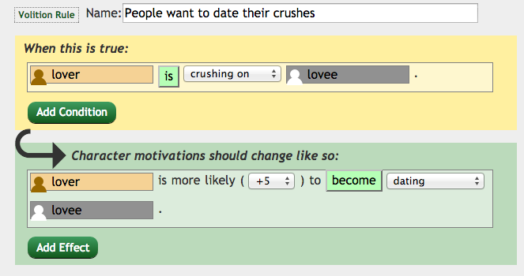
A Little Easier on the Eyes
Notes:
And just so that we don’t have to stare at those kinda gross looking textual representations of influence rules, I’m going to be representing them using screen shots from an authoring tool for creating these rules.
So, even though it looks pretty different, this is exactly the same. That top part, with the yellow background that says “When this is True” is the “left hand side” of the rule, and right now it has a single predicate in it (but it could have more!) and the bottom part that says “Character motivations should change like so” – that is the right hand side of the rule.

Slide 85
Predicates
So, predicates are a pretty important part of these rules.
Each predicate is essentially one ‘check’ against the social state.
  Are two characters dating?
  Is this character angry at the other character?
  Does this character have a romance value greater than 80 towards this other character?
Notes:
So, predicates are a pretty important part of these rules.
Each predicate is essentially one ‘check’ against the social state. So all of those different aspects of the social state that we were talking about, traits, statuses, relationships, history, the ckb. All of those things can be included in these influence rules to govern character behavior.

Slide 86
A Simple Rule
“People want their friends to think they are cool.”
LHS
➔
RHS
Notes:
So, to make this concept clear, let’s build a simple rule together: people want their friends to think they are cool. We start off with the left hand side and the right hand side of our rule. And we see that this is a rule that is pertaining to friends. IF two characters are friends, THEN we want to change volitions.

Slide 87

A Simple Rule
“People want their friends to think they are cool.”
➔
RHS
Notes:
So the left hand side falls into place quite naturally: we just have a single predicate: that x and y are friends. Now, we use x and y here as place holders for characters. We don’t want to use specific character names here, because we want this rule to be generic/flexible/dynamic enough to apply to any pair of people who are friends. If we used specific character names, it would use a lot of its flexibility! You can think of it as specifying roles, not specific characters. And during the volition formation process, the characters in your world get bound to these rules.
Also, just as you can name your variable names x and y, but its usually good to name them something more descriptive, the same principle applies here – you can name the roles anything you want, as long as you’re consistent.
So, great, we’ve got the left hand side. And as for the right hand side, we want a volition that pertains to increasing a cool network.

Slide 88
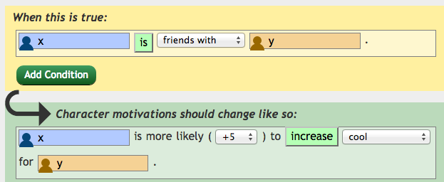
A Simple Rule
“People want their friends to think they are cool.”
Notes:
Which I’ll just tell you now would be something like this. X’s “Cool Up” volition towards Y goes up by 5, (or any number, really).

Slide 89
A Simple Rule
So, the character that gets ‘bound’ to x is more likely to do actions that increase ‘y’s network of cool for them.
Notes:
So, the character that gets ‘bound’ to x is more likely to do actions that increase ‘y’s network of cool for them. So, more inclined to take actions like bragging, or showing off in front of them.

Slide 90
Rules can be more complex
“The Enemy of my Enemy is my Friend”
LHS
➔
RHS
Notes:
Rules can be more complex than that, of course. Take, for instance, the old adage “the enemy of my enemy is my friend.” So, in this situation we are dealing with three characters – The enemy, the enemy of my enemy, and myself, as it were.

Slide 91

Rules can be more complex
“The Enemy of my Enemy is my Friend”
➔
RHS
Notes:
So, we can encode the idea of “my enemy” easily enough. We’ll write this rule from the perspective that we are x. So, our first predicate is saying that x and y are enemies. Great! But now we need to encode the idea that our enemy has an additional enemy of his own. We can do that with with another predicate!

Slide 92
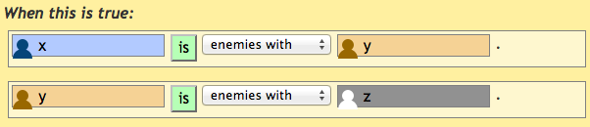
Rules can be more complex
“The Enemy of my Enemy is my Friend”
➔
RHS
Notes:
So, we’ve added a new predicate here! That that same character ‘y’ who was our enemy has their OWN ‘enemy’ relationship with a third character, represented by z. So, great, we’ve captured the idea of y being a mutual enemy of two other people, which seems like all we need on the left hand side.
All we need now is the RHS!

Slide 93
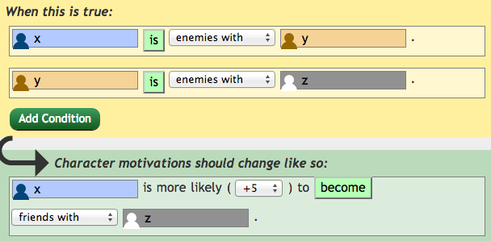
Rules can be more complex
“The Enemy of my Enemy is my Friend”
Notes:
And so that sounds like the character x will have an increased desire to start a friendship with the character bound to the ‘z’ role, by 5 or whatever.
Ta-da! Another rule in the bank!

Slide 94
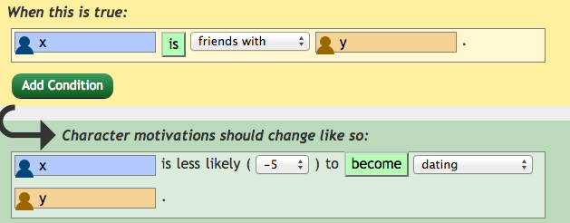
Negative Volition Rule
“Friend Zone”
Notes:
Rules can also contribute negatively to volition. So, here we can see a rule that says that if X and Y are friends, then X’s volition to start dating Y actually goes down. This rule is saying that friends are less likely to start dating each other, or in other words, it captures one small aspect of the mysterious phenomenon known as the “friend zone.”

Slide 95
Putting it all Together!
We have two characters
Doug
Chloe
Notes:
So, given all that we know, let’s put it all together in a simple example. Let’s start with these two familiar faces, Doug and Chloe.

Slide 96
Putting it all Together! Our Social State
We have two characters
  They’re friends
Friends
Doug
Chloe
Notes:
In this example, The two of them have the relationship friends.

Slide 97
Putting it all Together! Our Social State
We have two characters
  They’re friends, Doug has a crush on Chloe
Friends
Has a Crush On
Doug
Chloe
Notes:
And Doug has the directed status “has a crush on” Chloe. And that’s it! That’s all of the social state we need for this example!

Slide 98
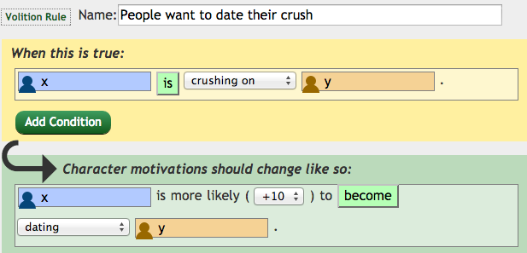
Putting it all Together! Our Influence Rules
Let’s just have two influence rules in this world.
  “Friend Zone”
And a new one
Notes:
And let’s say that we have two influence rules in this social world. The “Friend Zone” one we wrote just a moment ago – if you are friends with someone you are less likely to want to date them, and a new one: “people want to date their crush.”
And this new rule is pretty easy to encode! Our left hand side is just a single predicate checking to see if X has the status “has a crush on Y” and, if so, increases X’s volition to start dating Y by 10.

Slide 99
Volition Formation
So, we’re now determining what our two heroes want to do with each other.
Notes:
So, when we’re doing volition formation, we’re going to determine what the two characters want to do with each other.

Slide 100
Volition Formation
So, we’re now determining what our two heroes want to do with each other.
First, let’s calculate Chloe’s volition towards Doug.
Notes:
First, let’s calculate Chloe’s volition towards Doug.

Slide 101
Volition Formation
So, we’re now determining what our two heroes want to do with each other.
First, let’s calculate Chloe’s volition towards Doug.
We do this by going through all of the rules, and binding our characters to the different role slots.
  So, we’ll be exchanging “X” for Chloe, “Y” for Doug, etc.
Notes:
We do this by going through all of the rules in the system (which is only those two right now), and essentially exchanging “x” for Choe, and “Y” for Doug. This is that process of role binding I alluded to earlier.

Slide 102
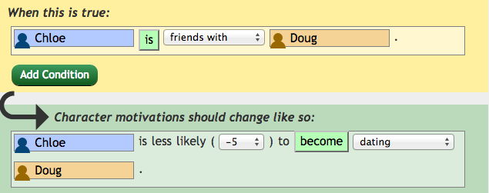
Volition Formation – Chloe->Doug – 1st Rule
Starting with our Friend Zone rule…
Becomes…
Notes:
So, in the volition formation process, we take those generically written rules, and BIND characters to the roles. So here, we’ve bound X to Chloe and Y to Doug. And just to be clear – this is happening internally when you ask our AI system to calculate volitions. You don’t have to actually write an influence rule with character names in them because again, that would limit the flexibility of the system. We’re just writing the character’s names in these rules to help expose the internal process of the system.
So, internally, the characters have been bound to roles—all of the X’s have become Chloes and all of the Y’s have become Dougs, and that enables us to actually check against the social state to see if things are true or not. So we see here, the left hand side is asking us if Chloe and Doug are friends
And as you may recall…

Slide 103
Our Social State
We have two characters
  They’re friends, Doug has a crush on Chloe
Friends
Has a Crush On
Doug
Chloe
Notes:
Doug and Chloe are in fact friends!

Slide 104
Volition Formation – Chloe->Doug – 1st Rule
Starting with our Friend Zone rule…
Becomes…
Notes:
That means that when we check the left hand side of this predicate… it will evaluate to true! Chloe and Doug are in fact friends!

Slide 105
Volition Formation – Chloe->Doug – 1st Rule
Starting with our Friend Zone rule…
Becomes…
Notes:
Which means that the right hand side of the volition rule fires; Chloe’s desire to start dating Doug goes down by 5. So, her total volition to start dating doug is at -5 right now.

Slide 106
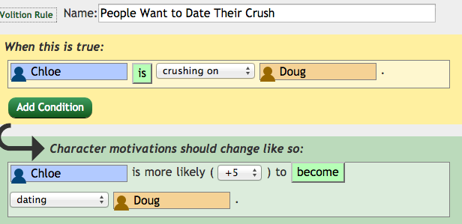
Volition Formation – Chloe->Doug – 2nd Rule
Moving on to our Crush rule…
Becomes…
Notes:
We then move on to our second rule—you’re more inclined to want to date someone you have a crush on. Through that same binding process, we’ve replaced the X and the Y with Chloe and Doug, and now we check our social state to see if Chloe has a crush on Doug. And as I’m sure you all remember.

Slide 107
Our Social State
We have two characters
  They’re friends, Doug has a crush on Chloe
Friends
Has a Crush On
Doug
Chloe
Notes:
She does not! That arrow is only going in one direction!

Slide 108
Volition Formation – Chloe->Doug – 2nd Rule
Moving on to our Crush rule…
Becomes…
Notes:
So the rule does NOT fire, and her volition does not change.
And because that’s all of the rules we have in the system, we’re done with this particular binding (Chloe for X, Doug for Y). So we now know Chloe’s volition!

Slide 109
The Story Thus Far
Chloe’s Volition: StartDating Doug : -5
Doug’s Volition: ???
  We find out by binding Doug to X, and Chloe to Y!
Notes:
Namely that she does not want to date Doug! Specifically with a score of -5. However, we don’t know anything about Doug’s volition yet, but we can easily find out by binding the characters to the different roles. Now we’ll bind Doug to X, and Chloe to Y!

Slide 110
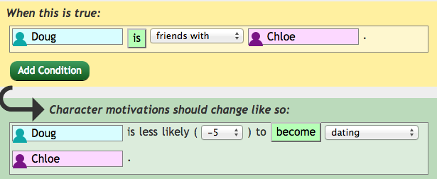
Volition Formation – Doug->Chloe – 1st Rule
Starting with our Friend Zone rule…
Becomes…
Notes:
So we return to our friend zone rule. Now we see we’ve bound Doug in the x slot, and Chloe in the y slot.

Slide 111
Volition Formation – Doug->Chloe – 1st Rule
Starting with our Friend Zone rule…
Becomes…
Notes:
Just as before, we ask ourselves if the left hand side is true…

Slide 112
Volition Formation – Doug->Chloe – 1st Rule
Starting with our Friend Zone rule…
Becomes…
Notes:
And as I trust we all remember, it is! They are friends! So this fires, and Doug’s volition to start dating Chloe is at -5.

Slide 113
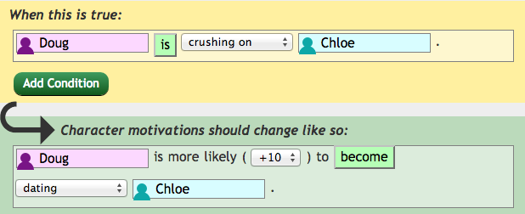
Volition Formation – Doug->Chloe – 2nd Rule
Moving on to our Crush rule…
Becomes…
Notes:
And so we move on to our second rule, where we check if x has a crush on Y, where Doug is now X, and Chloe is now Y. And… TADA!

Slide 114
Our Social State
We have two characters
  They’re friends, Doug has a crush on Chloe
Friends
Has a Crush On
Doug
Chloe
Notes:
Yes! Yes he does!

Slide 115
Our Social State
We have two characters
  They’re friends, Doug has a crush on Chloe
Friends
Has a Crush On
Doug
Chloe
Notes:
He does have a crush on her!

Slide 116
Our Social State
We have two characters
  They’re friends, Doug has a crush on Chloe
Friends
Has a Crush On
Doug
Chloe
Notes:
He has a big crush on her!

Slide 117
Volition Formation – Doug->Chloe – 2nd Rule
Moving on to our Crush rule…
Becomes…
Notes:
So when we view this rule from Doug’s perspective, it fires! Increasing his volition to start dating Chloe by 10 whole points!

Slide 118
Doug is Conflicted!
Doug knows it’s generally not a great idea to date your friends (-5)
But he has a big a crush on her (+10)
Doug’s total volition to StartDating Chloe: +5
Notes:
So what we have here is Doug being conflicted!
He knows it’s not a great idea to date your friends (at least in this toy world. Maybe in real life becoming friends with someone before you date them is a great foundation for a strong relationship! It probably is! Who knows!)
But regardless, his crush on Chloe is strong enough that it overpowers this social norm, and overall gives him a positive volition to try to start dating her.

Slide 119
Doug is Conflicted!
Doug knows it’s generally not a great idea to date your friends (-5)
But he has a big a crush on her (+10)
Doug’s total volition to StartDating Chloe: +5
Chloe’s total volition to StartDating Doug : -5
Notes:
Of course, we remember that Chloe doesn't feel the same way about him. And given that we live in a world where these are the only two social rules, and the only action appears to be an attempt to start dating, we can see that its going to be pretty uncomfortable for both of them pretty quickly.

Slide 120
A Sad World
Namely:
  Doug will try doing various actions like AskOut and PickUpLine to sweep Chloe off her feet.
    And she’ll reject him.
Notes:
Namely, Doug’s volition to “startDating” Chloe will translate into him trying to take specific actions like “AskOut” or PickUp line. However, we know Chloe isn’t interested in Doug like that, so she’ll reject him.

Slide 121
A Sad World
Namely:
  Doug will try doing various actions like AskOut and PickUpLine to sweep Chloe off her feet.
    And she’ll reject him.
  Chloe has no positive volitions, so she just has to stand around while this jerk keeps on bugging her.
Notes:
Meanwhile, Chloe *has* no positive volitions, so she’ll just have to stand around while this jerk keeps on bugger her, refusing to take a hint.

Slide 122
A Sad World
Namely:
  Doug will try doing various actions like AskOut and PickUpLine to sweep Chloe off her feet.
    And she’ll reject him.
  Chloe has no positive volitions, so she just has to stand around while this jerk keeps on bugging her.
How can we save these two?
Notes:
Fortunately, there are lots of ways we can save these guys from this grim and awkward fate.

Slide 123
Ways to Save Them
Adding rules for other volitions
  E.G., give characters ways to express their platonic friendship.
Notes:
There are lots of potential ways we can make this world a lot more interesting. We could add rules for other volitions; so trying to affect other aspects of the social state besides dating.

Slide 124
Ways to Save Them
Adding rules for other volitions
  E.G., give characters ways to express their platonic friendship.
Adding rules that take history to account
  E.G., Once you’ve been rejected, you are less likely to ask again.
Notes:
We could add rules that take history into account, so that once a character has been rejected they get a clue and stop bothering someone who isn’t interested.

Slide 125
Ways to Save Them
Adding rules for other volitions
  E.G., give characters ways to express their platonic friendship.
Adding rules that take history to account
  E.G., Once you’ve been rejected, you are less likely to ask again.
Adding more characters
  Doug and Chloe will form volitions for any additional characters, who will in turn form volitions back for them.
Notes:
Or we could add more characters, which means that more people will be included in that role-binding process, and Doug and Chloe will have new volitions formed for these new characters (who will also have volitions for Doug and Chloe in turn).

Slide 126
Sounds Pretty Fun, Huh?
Doesn’t this make you want to design social worlds of your very own?
Notes:
So, sounds pretty fun, right? I bet the only thing that would be funner than learning all about Doug and Chloe's sorry state of affairs would be to make social worlds of your very own, right?

Slide 127
Enter: Ensemble Engine!
Well now you can!
Notes:
Well NOW YOU CAN!

Slide 128
Enter: Ensemble Engine!
Well now you can!
We’ve been developing the Ensemble Engine, which is the next generation of the AI system used to create Prom Week.
  You can specify the ‘types’ of social facts yourself.
  More expressive influence rules
  More complicated actions
  And a brand new authoring tool…
Notes:
Many of the same folks involved in making Prom Week have been developing the Ensemble Engine, the next generation of the AI system used to create Prom Week. And although its still being actively developed, its also available for download by anyone who is interested in creating their own social worlds!

Slide 129
Enter: Ensemble Engine!
Well now you can!
We’ve been developing the Ensemble Engine, which is the next generation of the AI system used to create Prom Week.
  You can specify the ‘types’ of social facts yourself.
  More expressive influence rules
  More complicated actions
  And a brand new authoring tool…
Notes:
The Ensemble Engine has a variety of nice features. It lets you define your own categories and types of social state yourself. You want the relationships and statuses that we used in Prom Week. Sure, you got it! But If you’re making a world where nothing is ever reciprocated? Great! Done! No relationships. No reciprocation. Or you’re making a world where EVERYTHING is reciprocated, where everyone has some kind of soul link to each other and whenever one thing happens from one person to another it always goes back the other way too? Great, you want it you got it!
It’s capable of allowing the authoring of more expressive influence rules. The actions can be more complicated, and can involve any number of people, and there’s also a brand new authoring tool for creating and testing your social simulation.

Slide 130
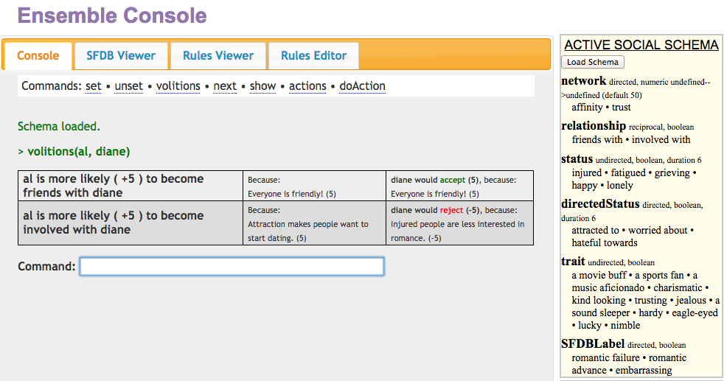
The Ensemble Tool - Console
Notes:
I don’t want to go into too much detail now as it’s tough to convey the usability of a tool just from screenshots, but I want to give you all a glimpse as to the kinds of things you can do in the tool.
There’s a command line interface, that will easily let you see the volitions that a character has towards the other characters (as shown here). From here you can also quickly adjust the social state by assigning or removing social facts to people.

Slide 131
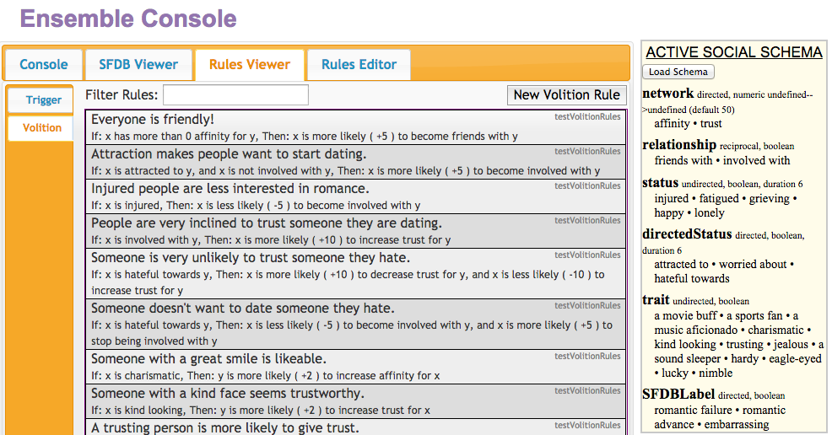
The Ensemble Tool – Rule Viewer
Notes:
You can see a big list of all of the influence rules that you’ve written for the system. And if you click on any of them (or click on that “new volition rule” button)

Slide 132
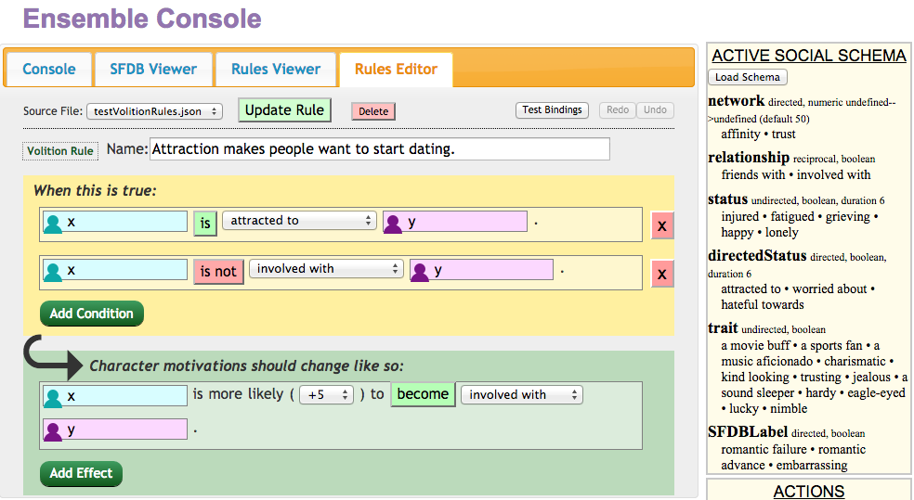
The Ensemble Tool – Rule Editor
Notes:
It’ll take you to the Rule Editor. This should hopefully look a little familiar to you! Here you can see a nice representation of the LHS (it’s the part with the yellow background) and the RHS (it’s the part with the green background) just as we were discussing before. Making it fun and easy to author your own social rules!
So, we’ve had quite the journey together today.

Slide 133
In Conclusion
Thank you very much for your time!
Notes:
Thank you very much for your time!

Slide 134
In Conclusion
Thank you very much for your time!
Social Physics is exciting!
Notes:
Hopefully, I've managed to convince you that social physics is, in fact, an exciting direction to take works of interactive narrative

Slide 135
In Conclusion
Thank you very much for your time!
Social Physics is exciting!
And YOU have the power to use it!
Notes:
And even more importantly, that you feel that *you* now have the power to create your own social worlds using the Ensemble Engine.

Slide 136
In Conclusion
Thank you very much for your time!
Social Physics is exciting!
And YOU have the power to use it!
Push the limits of what it means to be work of interactive narrative!
Notes:
But regardless, I encourage all of you to push the limits on what it means to be a game, and what it means to be a piece of interactive narrative. Push on those boundaries! Discover uncharted territory! You're in college, you have your whole lives ahead of you! Now is the time to be courageous in your design.
Whether that involves social physics or not, you can do anything.

Slide 137
In Conclusion
I have the status of believing in you all
Notes:
I believe in all of you.

Slide 138
Thanks! Any Questions?
Ben Samuel – bsamuel@ucsc.edu
This work would not have been possible without: Aaron Reed, Paul Maddaloni, Noah Wardrip-Fruin, Michael Mateas, Josh McCoy, Mike Treanor, and many more.
Notes:
Thanks again! Any questions?

